Slide 1

Android Development using Jetpack Compose
Hosted by GDSC, JIIT

Slide 3
Program Overview

Slide 4
Flow of the Camp
Day 1
Overview of App Development and Android Studio
Basic Kotlin Programming -> Kotlin Playground
Making UI using Jetpack Compose
Day 2
Connect with Backend - Firebase
Install and Run App

Slide 5
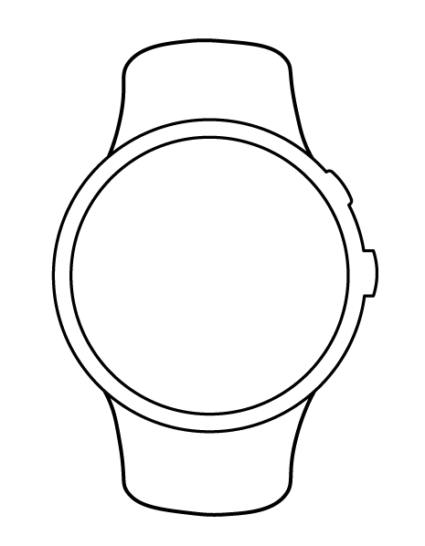
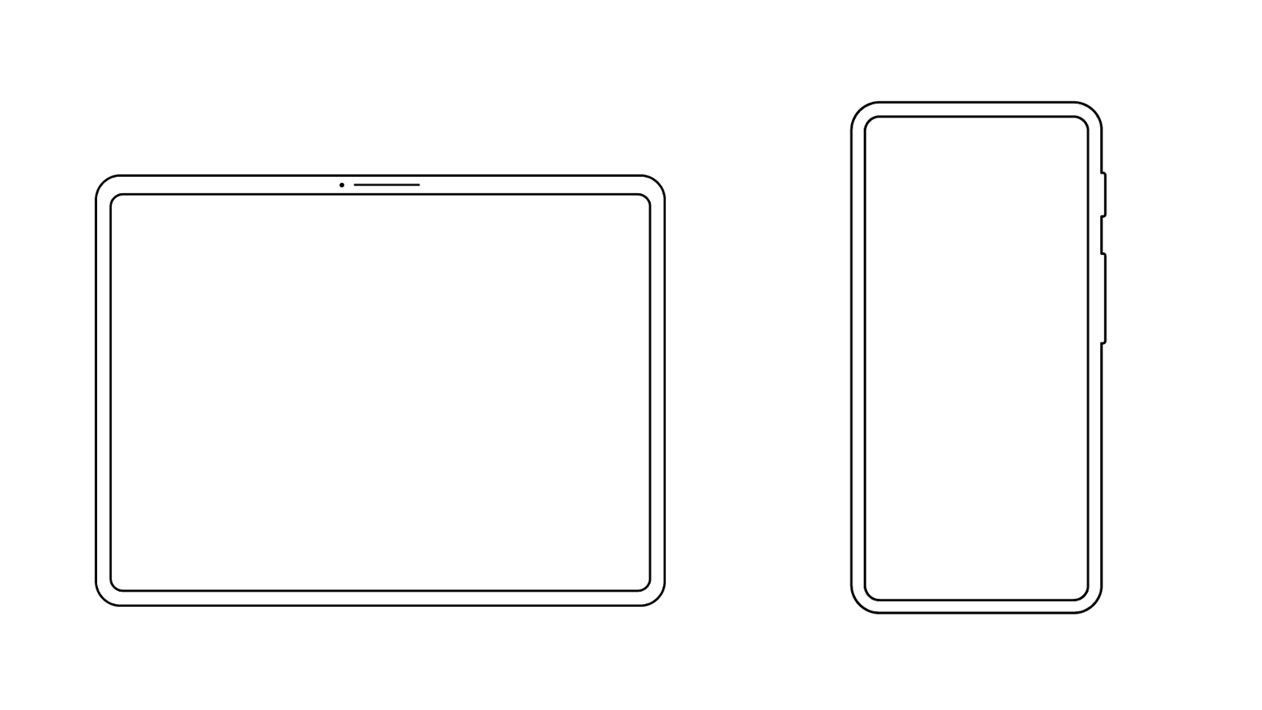
Jetpack Compose is the modern toolkit for building native user interfaces for Android apps.
Compose makes it easier and faster to build UIs on Android.

Slide 6

Compose apps are written in the Kotlin programming language.
Kotlin is the language that the majority of professional Android developers use to build apps.

Slide 7
Benefits of using Jetpack Compose
Less code
Do more with less code and avoid entire classes of bugs. Code is simpler and easier to maintain.
Intuitive
Just describe your UI, and Compose takes care of the rest. As app state changes, your UI automatically updates.
Accelerates Development
Compatible with all your existing code so you can adopt when and where you want. Iterate fast with live previews and full Android Studio support.
Powerful
Create beautiful apps with direct access to the Android platform APIs and built-in support for Material Design, Dark theme, animations, and more.

Slide 8

How can developers learn Compose?
Individually
On their own through the self-paced materials on developer.android.com.
Group Learning Environment
With other learners in their community at Compose Camp sessions, hosted by organizers like YOU!

Slide 9

To start, choose a track for your community
Beginner
New to Android app development. May or may not have prior programming experience.
Experienced
Experienced Android developers (already familiar with Kotlin and the View system) who are new to Compose.

Slide 10

Beginner Track

Slide 11

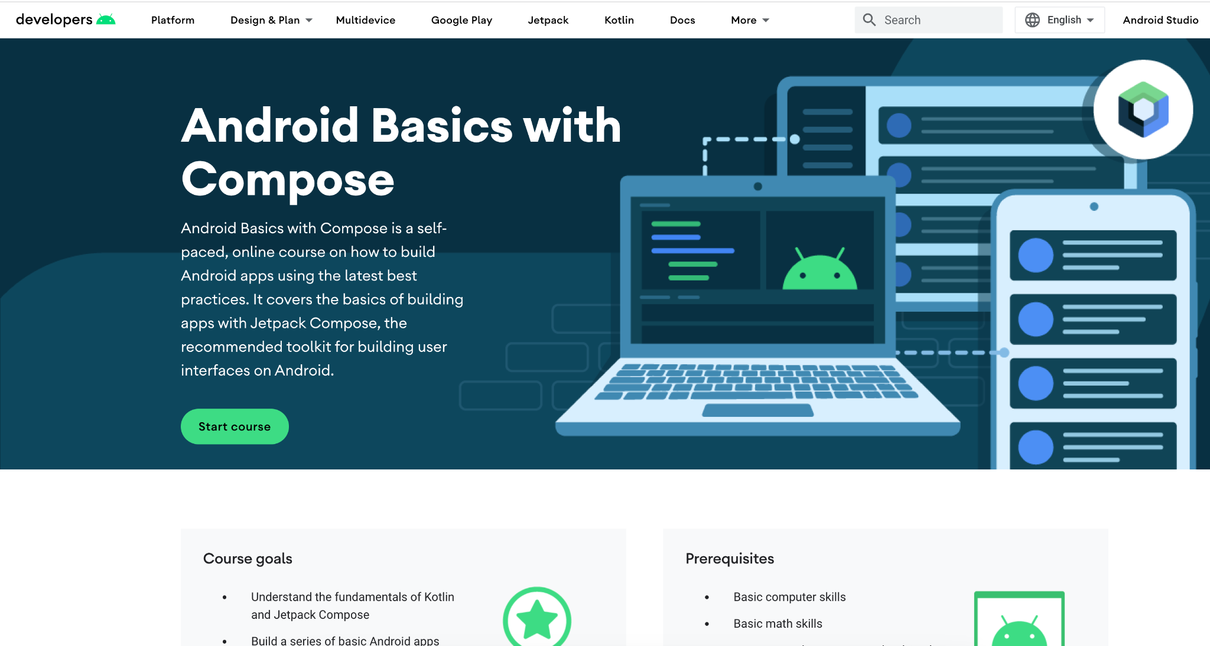
Android Basics
with Compose Course

Slide 12

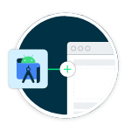


Earn digital badges
For each quiz successfully passed

Slide 13
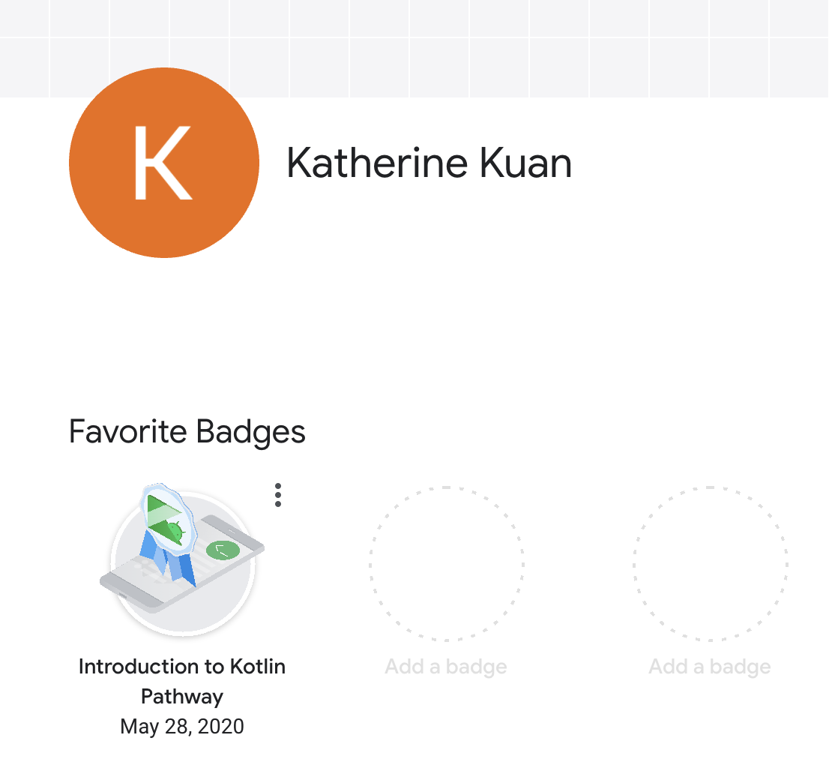
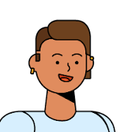
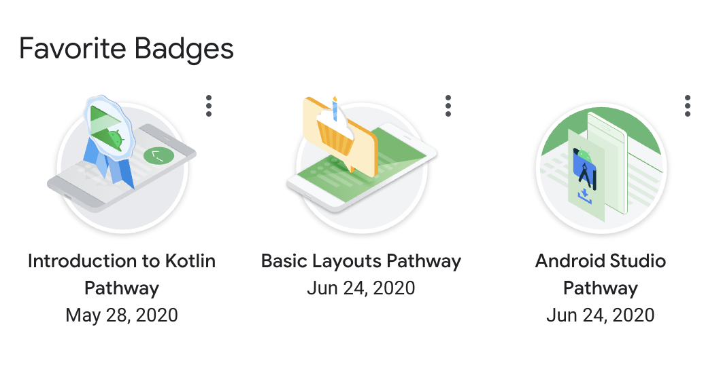
Badges are added to your
Google Developer Profile
Carrie Sawyer
See Developer Profile FAQ

Slide 14

Let's Get Started

Slide 15

Thank YOU
You are welcome to build new features and contribute to the app on GitHub.

Slide 16
After the Workshop
Here are ways that developers can continue to advance their Android development skills after the series of Compose Camp sessions are over:
Google Developer Student Club Solution Challenge
Google Play Academy
Google Summer of Code
Google I/O conference, Android Developer Summit, KotlinConf
Share your badges from your Google Developer Profile
Share Compose tips with other developers and have a chance to be featured

